Slide 1
SWAC & WITTS
School Within A College & Women in the Trades,
Limestone District School Board

Slide 2

School within a College Program
DUAL CREDIT PROGRAM: Students will have the opportunity to earn high school credits and a college Dual Credit. Students will be taught by a LDSB teacher for their high school courses, and a college teacher for their Dual Credit.
  Location: St. Lawrence College Kingston
  SEATS: students from LDSB local high schools and/or Alternative education centres will participate
  DURATION: Dual Credit – from February to May (14 weeks)
  Dual credit options include: Welding, College and Career Success, Addictions
  High School Courses – from February to June (8 week blocks)

Slide 3
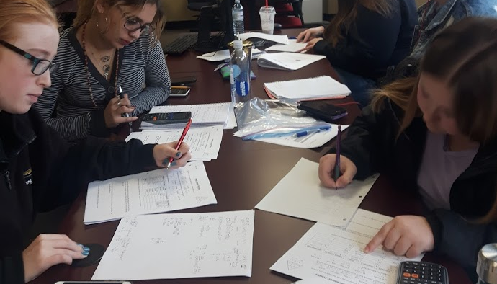
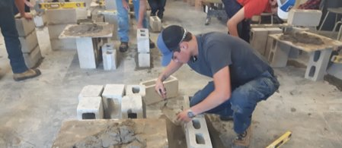
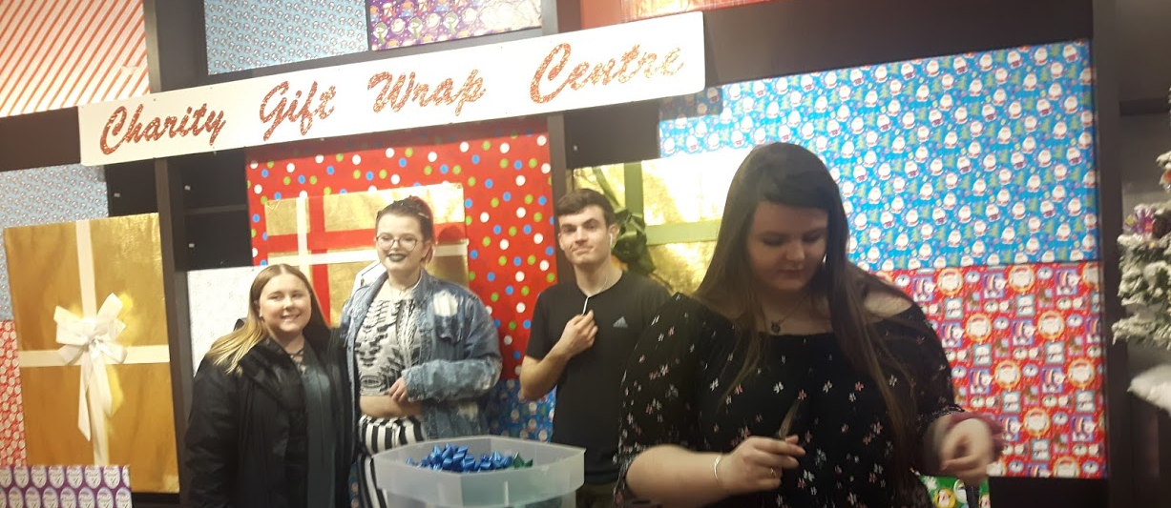
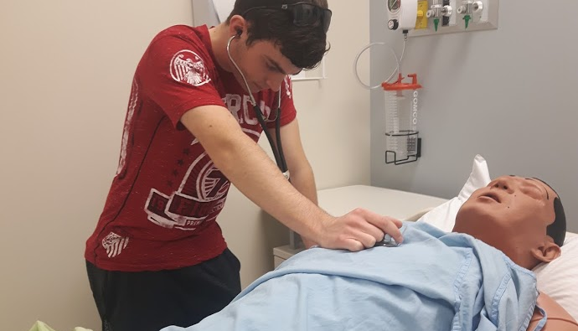

Slide 4
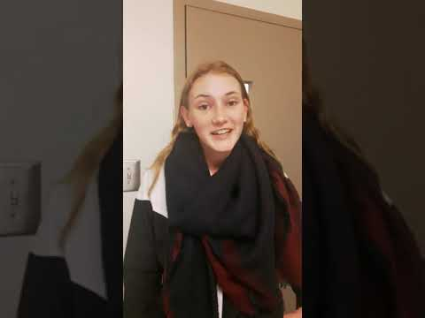

Slide 5
Women in the Trades SWAC
Trade’s exploration opportunity for grade 11 and 12 young women to explore the trades in a hands-on, supportive environment
Taste of the Trades Dual Credit includes 8 trades being taught by college instructors
Located at St. Lawrence College Kingston Mon-Fri
Credits:
  Senior English (NBE3C or ENG4C)
  Taste of the Trades Dual Credit
  Coop
  HSG3M Gender Studies

Slide 6
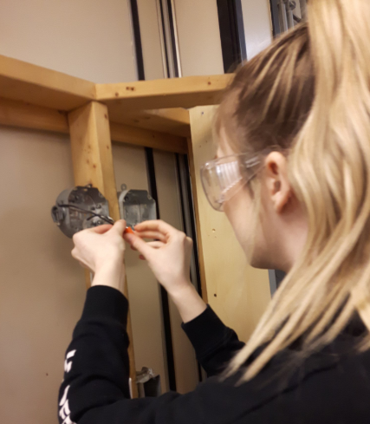
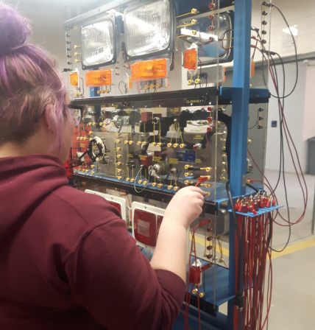
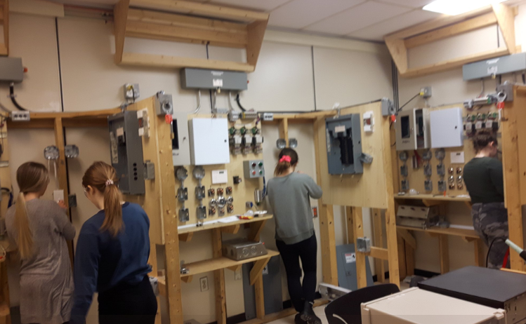
Dual Credit Includes:
Carpentry
Millwright
Electrical
Welding
Masonry
Plumbing
Esthetics
Culinary

Slide 7
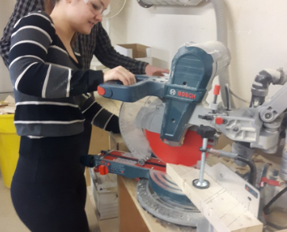
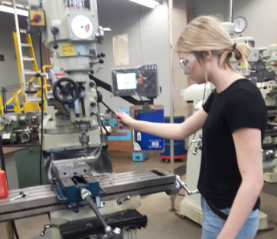
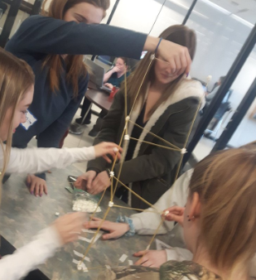
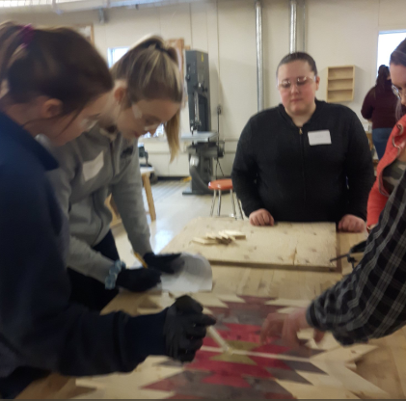

Slide 8
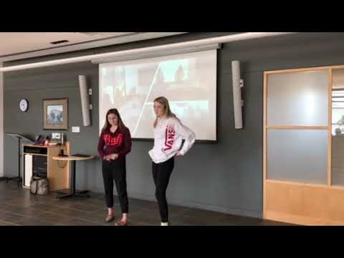
WITTS Student Testimonial

Slide 11
