Slide 1

SCHOOL BOARD TRUSTEES
ROLES
RESPONSIBILITIES
&
Local Government Week: October 16 to 20, 2023

Slide 2
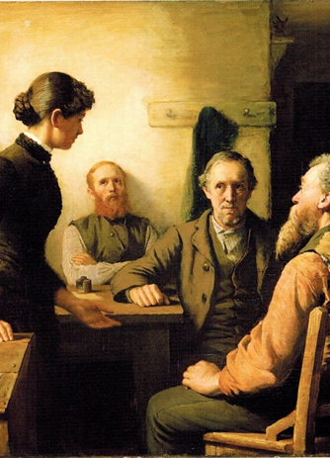
BRIEF HISTORY OF
SCHOOL BOARD TRUSTEES
  School board trustees are the oldest form of elected representation in Ontario.
  The office has been in existence since 1807 and represents citizens in the education decision-making process.
  The election of school board trustees is governed by the Education Act and the Municipal Elections Act, 1996. Both are the laws or rules that trustees follow.
A Meeting of the School Trustees
Robert Harris,1885

Slide 3
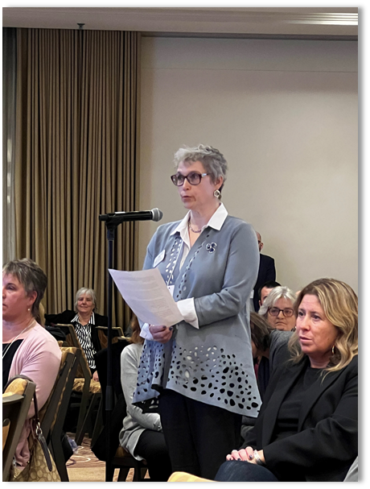
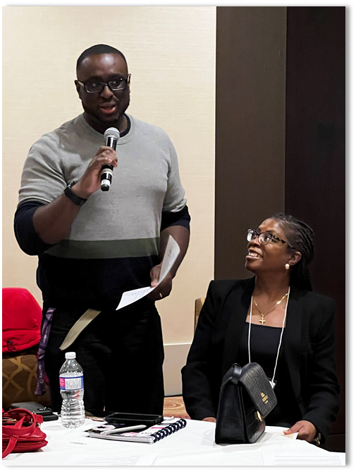
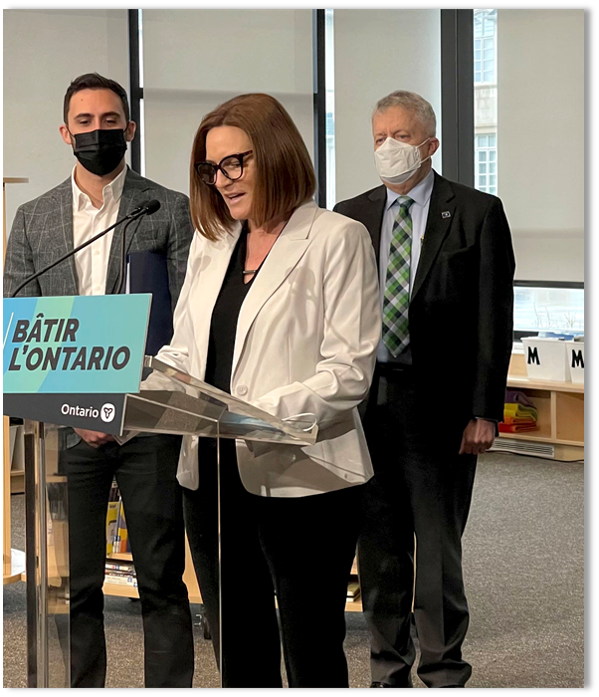
WHO AM I?
WHAT DO I DO?

Slide 4
WHO AM I?
WHAT DO I DO?
[Insert Slide About Yourself]

Slide 5
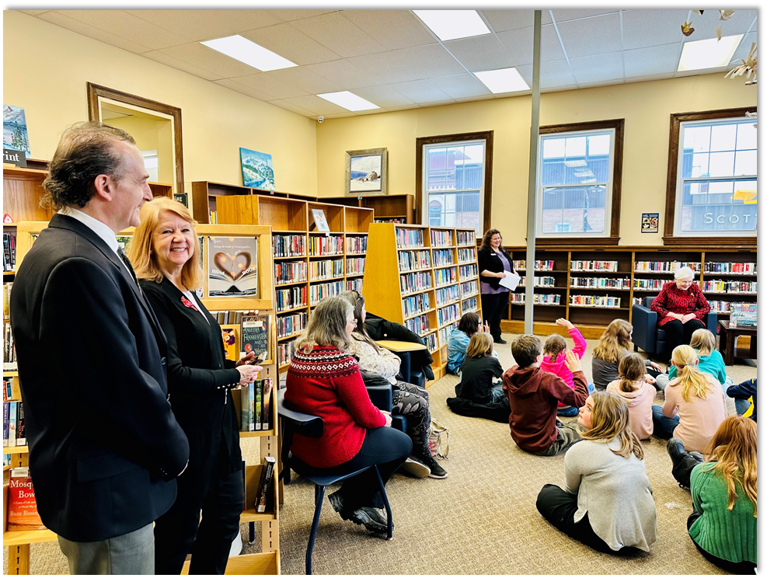
THE ROLE OF THE TRUSTEE
  School trustees are of the community, by the community and for the community.
  They are members of the district school board and are locally-elected representatives of the public.
  They are the community’s advocates for public education.
  Maintain focus on student achievement and well-being.
  Bring concerns of parents, students and supporters of the board to the attention of the district school board.
  Attend and participate in meetings of the board, including committee meetings.

Slide 6
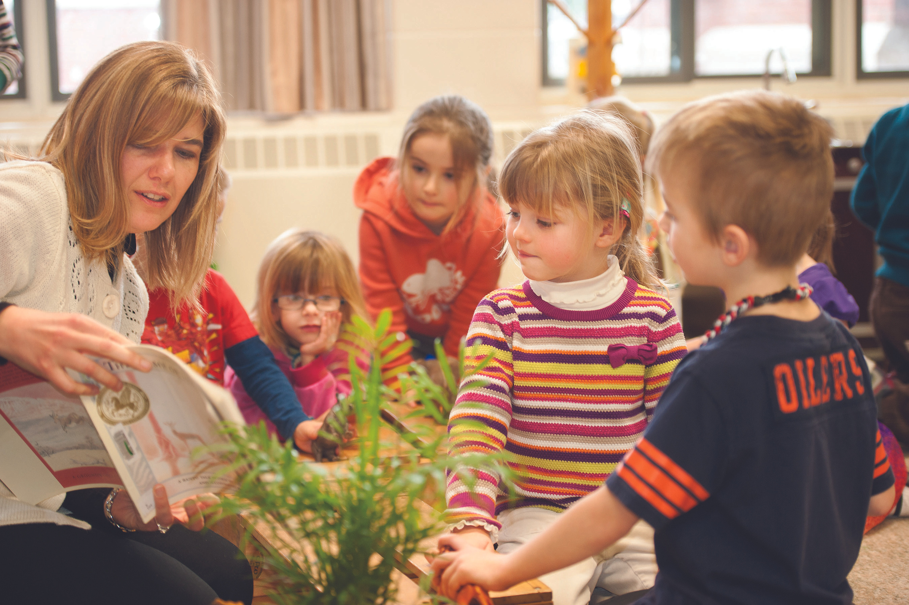
School boards trustees are locally and democratically elected.
School board trustees are the only publicly elected official with the direct responsibility for the education of our children.
School board trustees are communicators, problem solvers and most importantly, advocates for public education.
WHY ARE TRUSTEES IMPORTANT?

Slide 7

CLICK LOGO FOR VIDEO
Notes:
Make sure the sound on your device is on.

Slide 8
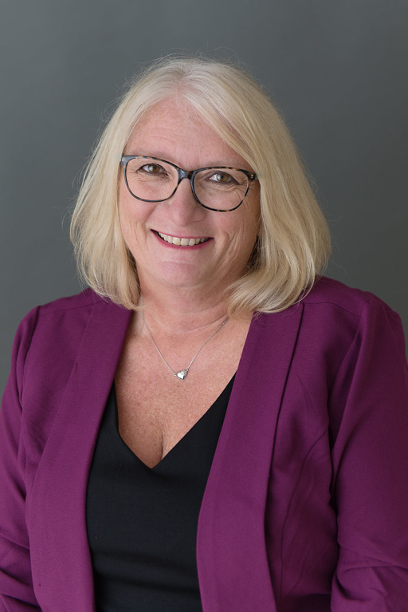
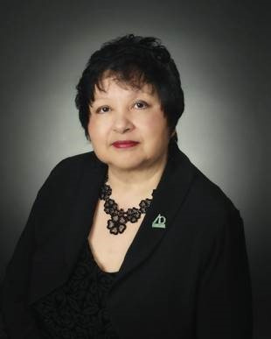
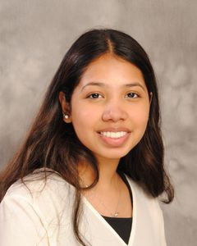
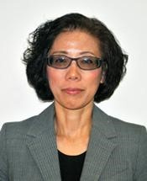
TYPES OF TRUSTEES

Slide 9
TYPES OF TRUSTEES
Trustees elected every four years during municipal and school board elections, including more than 320 publicly elected trustees representing 31 public English school boards and three school authorities across Ontario.

Slide 10
TYPES OF TRUSTEES
Indigenous Trustees appointed to the board by their First Nation. More than half of Ontario’s English public English school boards have Indigenous Trustees.

Slide 11
TYPES OF TRUSTEES
Student Trustees elected by the student body of the board. The Ontario Student Trustees' Association (OSTA-AECO) represents more than two million students.

Slide 12
TYPES OF TRUSTEES
Hospital board/school authority trustees are appointed by the Minister of Education for a term of four years, on the same term cycle as publicly elected trustees.

Slide 13
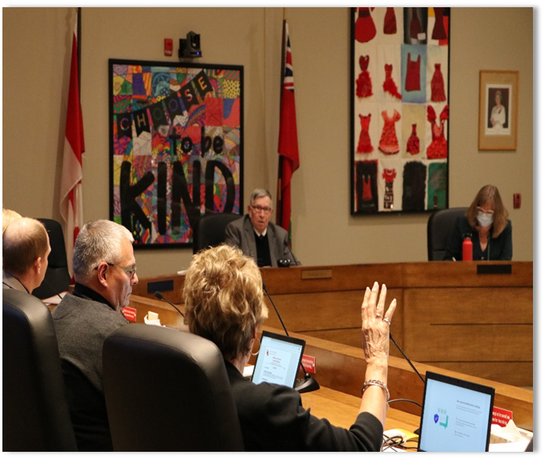
SCHOOL BOARD RESPONSIBILITIES
Student achievement and well-being.
Ensuring effective stewardship of the board’s resources.
Delivering effective and appropriate education programs for their students.

Slide 14
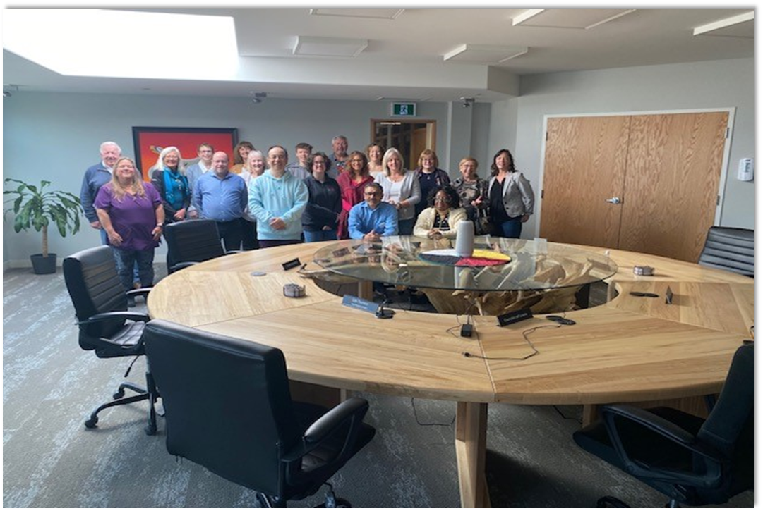
Parents & Caregivers
Trustees
Students (YOU!)
Teachers
WHO ARE THE PEOPLE IN A SCHOOL BOARD?
Education Workers
Director of Education
Principals
Supervisory Officers

Slide 15
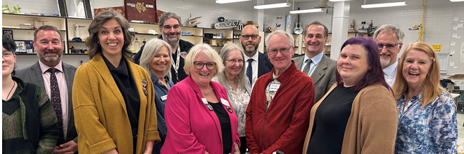
DO YOU KNOW YOUR SCHOOL BOARD?

Slide 16
X District School Board
CUSTOMIZE THIS SLIDE FOR YOUR LOCAL BOARD
Suggested content includes:
Local board facts and figures
Board logo
Photo of the Director of Education
Photo/list of board of trustees
Where is the head office? What departments are located there?

Slide 17
X District School Board
CUSTOMIZE THIS SLIDE FOR YOUR LOCAL BOARD
Suggested content includes:
List your board’s current priorities and main initiatives
Add your board advisory committees here, including PIC, SEAC, Indigenous Education, etc.

Slide 18
X District School Board
CUSTOMIZE THIS SLIDE FOR YOUR LOCAL BOARD
Suggested content includes:
Highlighting a key program, photos, videos

Slide 19
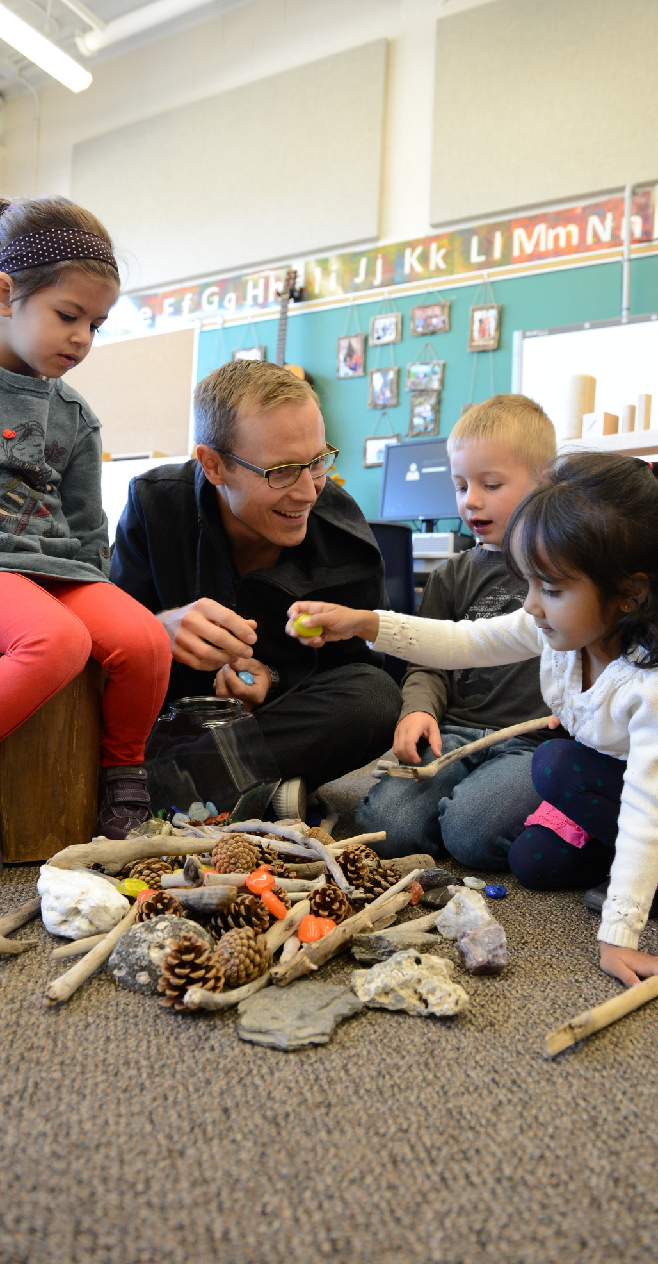


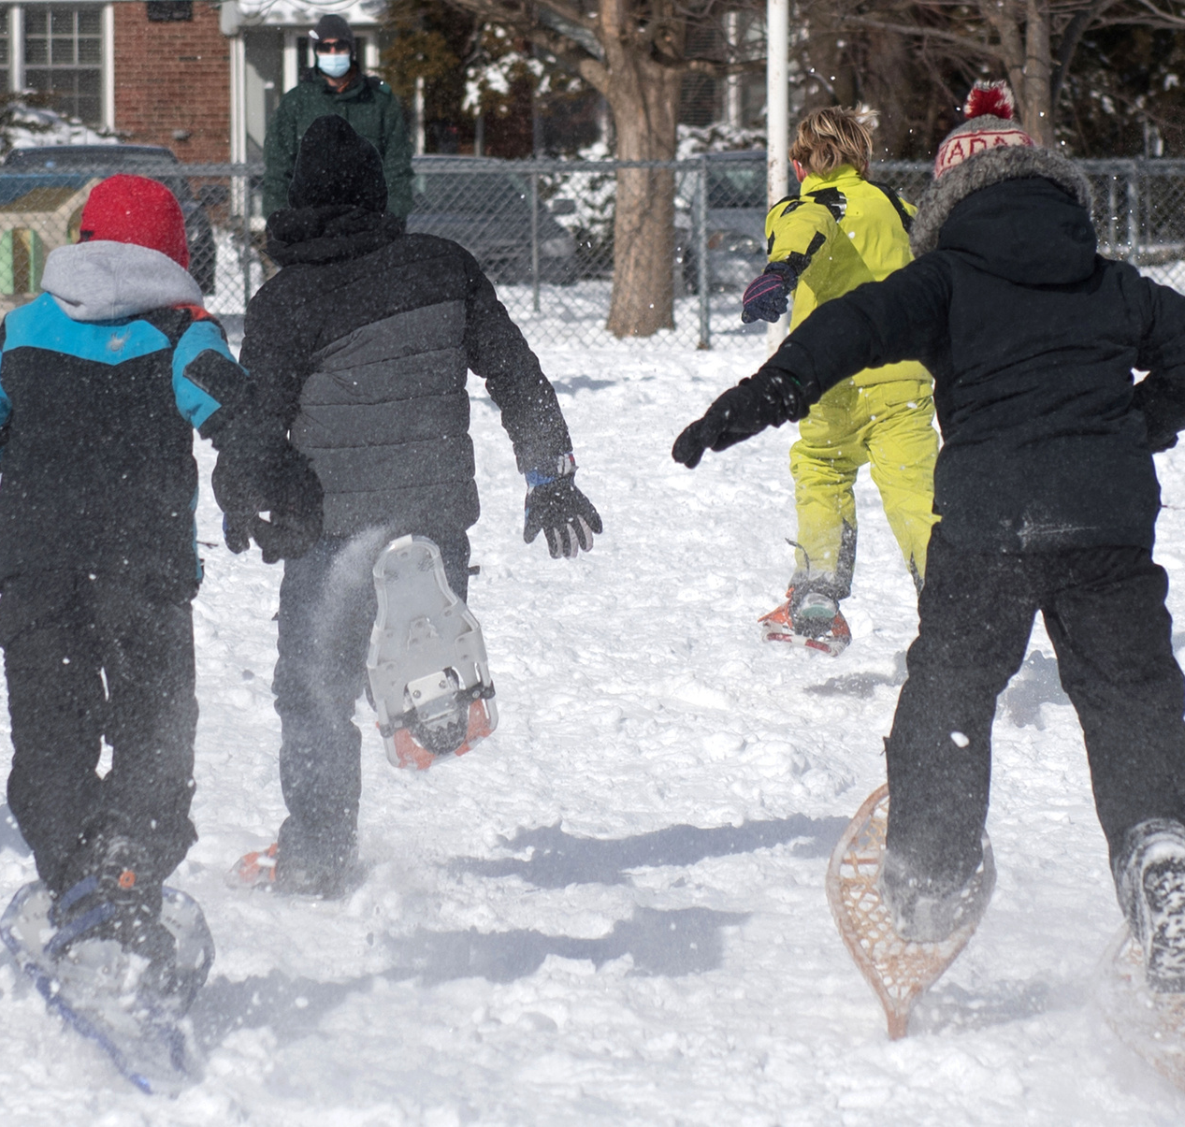
WHAT DO YOU THINK ARE SOME ISSUES RELATED TO EDUCATION?

Slide 20
Capital
Special Education
Child care
Indigenous Education
Children and Youth Mental Health
Student Achievement
SOME ISSUES RELATED TO EDUCATION
Equity, Diversity, and Inclusion
Well-being
Facilities
Transportation
Healthy Schools
Technology

Slide 21
WHAT ARE POLICIES & PROCEDURES?
  POLICIES
  Guidelines or rules used to govern actions and decisions.
  Achieving a group’s goals and values.
  Policies are usually broad.
  Policies are typically approved by management or governing bodies and are binding for all members of the organization.
  PROCEDURES
  A detailed step-by-step process that individuals within an organization must follow to carry out a specific task or implement a policy effectively.
  Procedures are more specific than policies, providing precise instructions on how to perform certain activities or operations.
  Serve as a guide to ensure consistency and standardization in completing tasks.

Slide 22
[Provide a recent/relevant example of an issues being addressed by your local school board]
Dress Code?
Student activities/programs?
Ask Classroom about thoughts on these relevant issues –
discussion, engagement, etc.

Slide 23

What are some rules in your classroom?
Why are these rules important?
Who makes the rules in the classroom?
What goals does your classroom have?

Slide 24
ABOUT OPSBA
Our board is a member of the Ontario Public School Boards’ Association (OPSBA), which represents 31 English public district school boards and 10 public school authorities across Ontario.
OPSBA’s members serve the educational needs of nearly 70% of Ontario’s elementary and secondary students. The Association, based in Toronto, advocates to the provincial government on behalf of the best interests and needs of the public school system in Ontario.
The Ontario Public School Boards’ Association (OPSBA) advocates for public education in Ontario
OPSBA will be public education’s expert voice, promoting a high-quality system, focused on improving every student’s success and well-being.
Equity, Diversity, and Inclusion
Truth and Reconciliation
Valuing Student Voice
Quality and Innovation
Environmental Stewardship, Good Governance, Accountability, Collaboration, and Integrity
MISSION
VISION
VALUES

Slide 25
Got a message or query? Reach out to me:
PICTURE
Name
Email
Social Media

